Slide 1

Opening a New SPA in Ha Noi, VietNam
Applied Data Science Capstone Project
IBM Data Science Professional Certificate Specialization
Nguyễn Xuân Toản
https://github.com/nxtacctau
Hà Nội, 2019.

Slide 2
Introduction
This report is for the final course of the Data Science Specialization. A 9-courses series created by IBM, hosted on Coursera platform.
The objective of this final assignment is to analyze and select best locations Ha Noi to open new Spa. I use data science methodology and machine learning techniques that have learned through 9 course in IBM Data Science Professional Certificate such as data collection, data cleaning, Foursquare location data, clustering to answer the business question: where to open new coffee how in Hanoi.

Slide 3
Data
List of Districts (neighborhoods) in Ha Noi.
Latitude and longitude coordinates of those neighborhoods to plot map and to get the venue data.
Venue data include Spa data to perform clustering on the neighborhoods.

Slide 4
Methodology
Use Data of Districts in Ha Noi.
Get Latitude and longitude coordinates using Geocoder
Visualize the map using Folium
Get venue Data using Foursquare API
Group Data by District (Neighborhood) and calculate the mean of the frequency occurrence of each venue category.
Filter venue category by Cafe
Use K-means clustering on the data to perform clustering on the data.
Visualize the clusters in a map using Folium

Slide 5
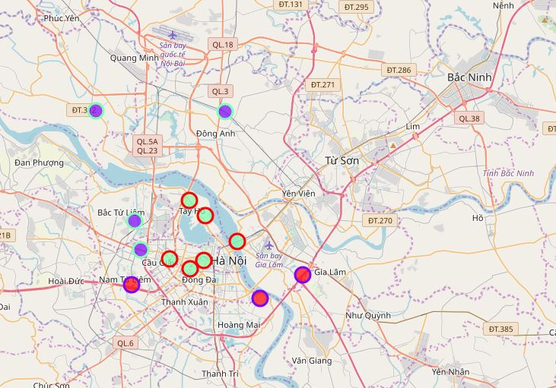
Results
3 Clusters have been made:
Cluster 0: District with moderate number of Spa
Cluster 1: District with low number to no existence of Spa
Cluster 2: Districts with low number to no existence of Spas

Slide 7
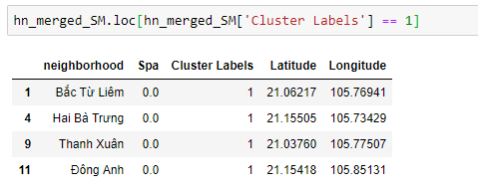
Cluster 1: District with low number to no existence of Spas

Slide 8
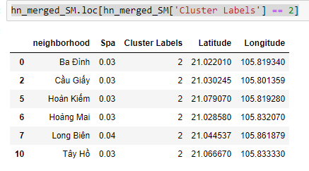
Cluster 2: District with high number of Spas

Slide 9
Discussion
As we can see from the picture in Results section, most of the Spas are in the district that located in center of Ha noi.
So If you want to develop new Spa, I recommend you do not open in Center of Ha noi (cluster 2) already high concentration of Spa and intense competitions.
Open new Spa in neighborhoods in Cluster 1: No existence of Spa, so there isn’t any competition.

Slide 10
Conclusion
In this Project I use only 1 factor as frequency of occurrence of Spas is used to find out the answer for the question from business and I still got the desired result.
There are other factors such as population, income, etc... that could influence the decision for investor to invest in Spa.
Through this project I show that with data science methodology, toolboxs we can use to solve real business problems.
We need to invest more money to get data and register the paid account in Foursquare to get more information.

Slide 11


